Slide 1
Manifold Technologies homework
Andrey Perfilyev

Slide 2
Objective
Given a number of algo trading strategies. Each strategy is a class inherited from the class BaseStrategy which has never been implemented.
The task is to build a system that allows to run such strategies, visualize their results and decisions.

Slide 3
Solution Overview
As a solution, we create a class BackTester, which has the following functionality:
function wrapStrategy() creates the class WrappedStrategy which inherits a given strategy class and implements its missing functions
function initialize_backtest() instantiates the wrapped strategy and defines its parameters from a config
function simulation() simulates the work of the strategy between given dates and computes its PnL
function save_results() saves simulation results: PnL, position over time and the log on disc

Slide 4
Simulation Logic
Initialization
New candle
Selection of instruments to enter and exit
PnL computation
Entry to positions

Slide 5
Visualization Tools
As a visualization of trading results, the class BackTester contains functions:
visualize_pnl() builds a plot of simulated PnL over time
visualize_instrument() for a given instrument, builds instrument’s daily price and the strategy’s position on that instrument over time. This helps to see at which points the strategy makes decisions

Slide 6
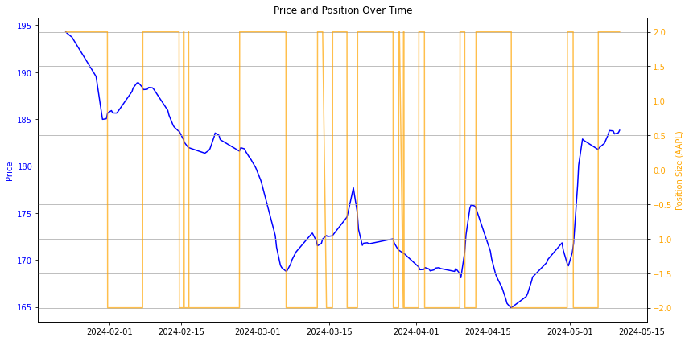
Strategy Decision Visualization Example

Slide 7
List of strategies that were able to run (20)
strategy_bollinger_bands_delivery
strategy_stochastic_crossover_intraday
strategy_rsi_macd_crossover_intraday
strategy_macd_crossover_delivery
strategy_ema_regular_order_delivery
strategy_inverse_ema_scalping_regular_order_delivery
strategy_volatility_trend_atr_intraday
strategy_mean_reversion_bollinger_bands_delivery
strategy_reverse_rsi_crossover_delivery
strategy_aroon_crossover_intraday
strategy_macd_crossover_intraday
strategy_ema_regular_order_intraday
strategy_stochastic_crossover_delivery
strategy_bollinger_bands_intraday
strategy_rsi_macd_crossover_delivery
strategy_mean_reversion_bollinger_bands_intraday
strategy_inverse_ema_scalping_regular_order_intraday
strategy_volatility_trend_atr_delivery
strategy_reverse_rsi_crossover_intraday
strategy_aroon_crossover_delivery

Slide 8
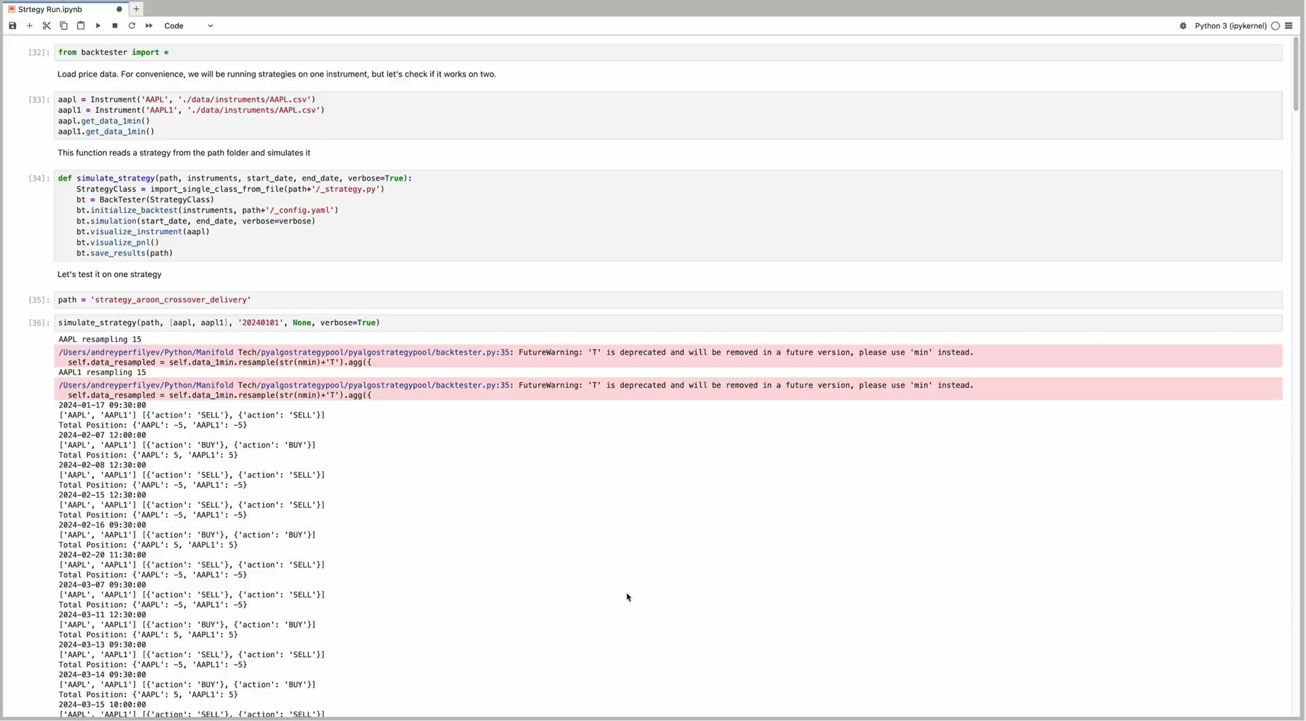
Simulation Launch

